Slide 1
FLC-PCR UI
James Ferguson

Slide 2
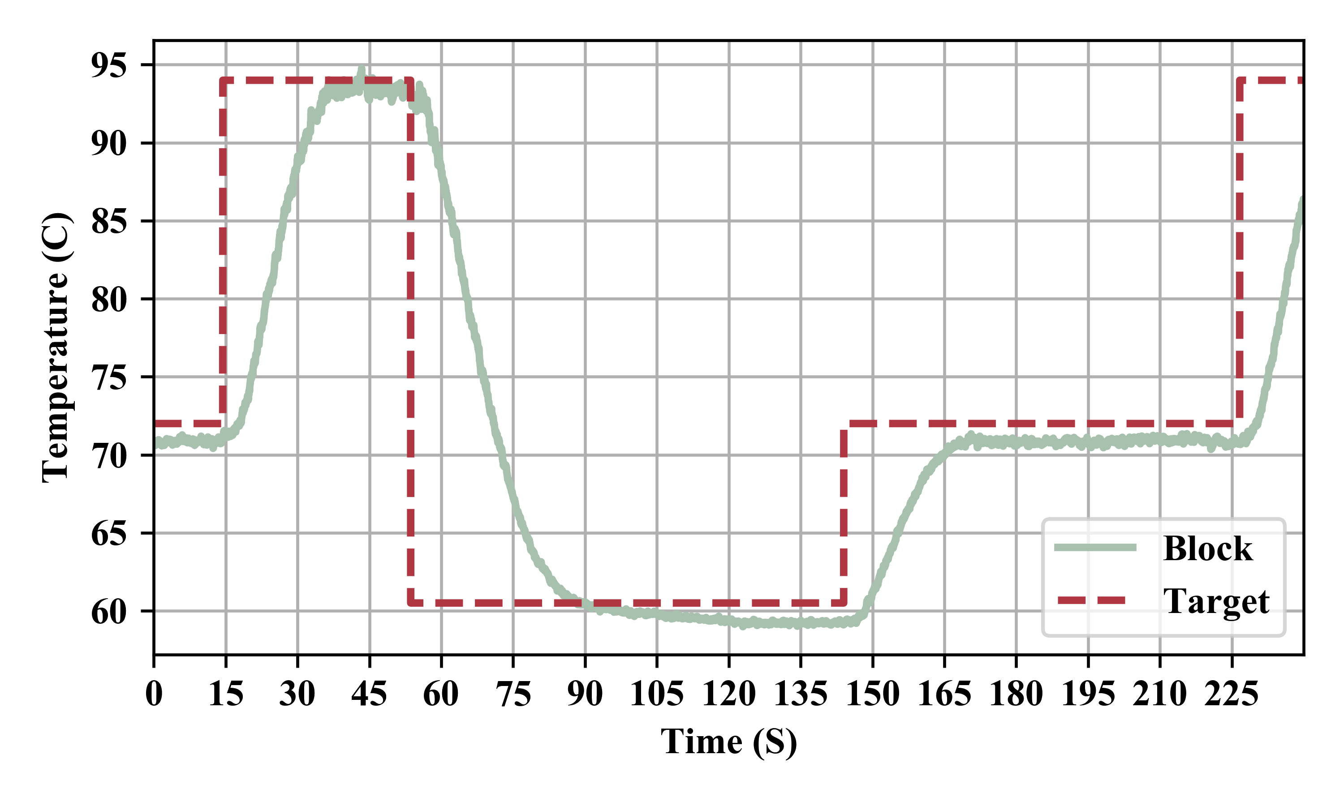
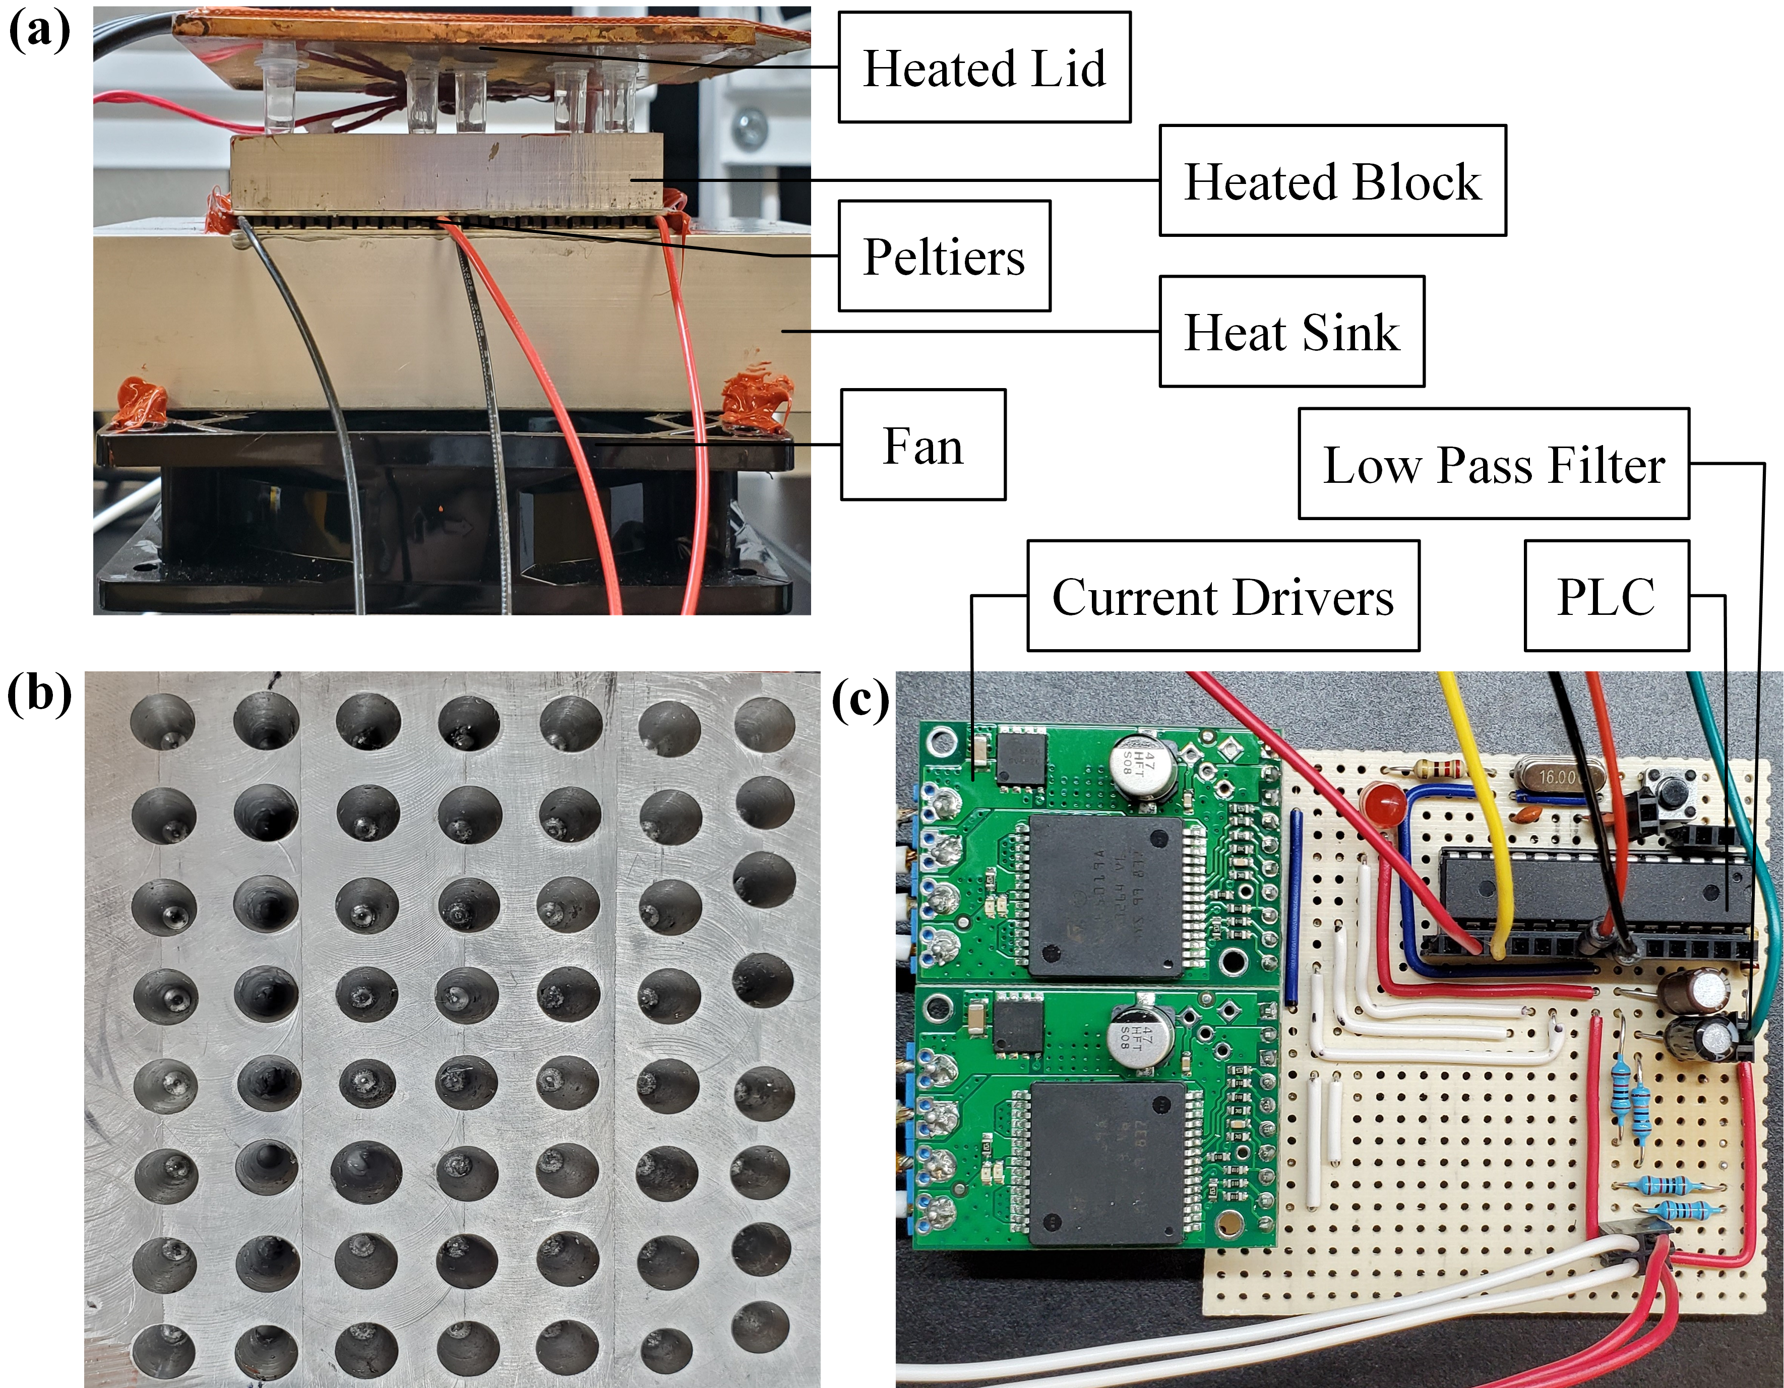
IEEE EMBC 2020 Paper

Slide 3

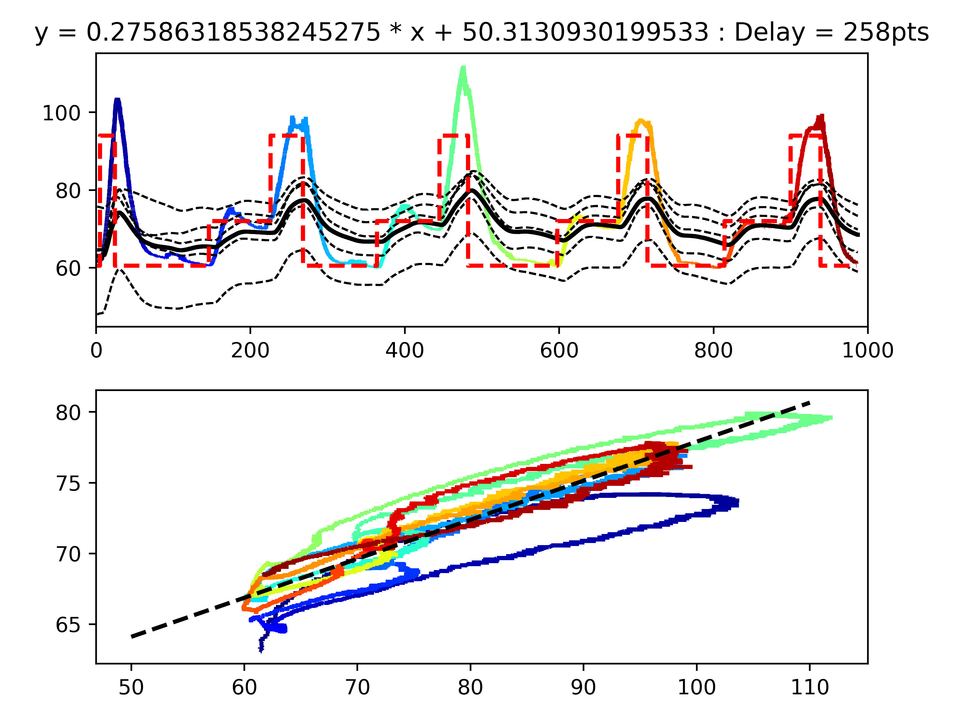
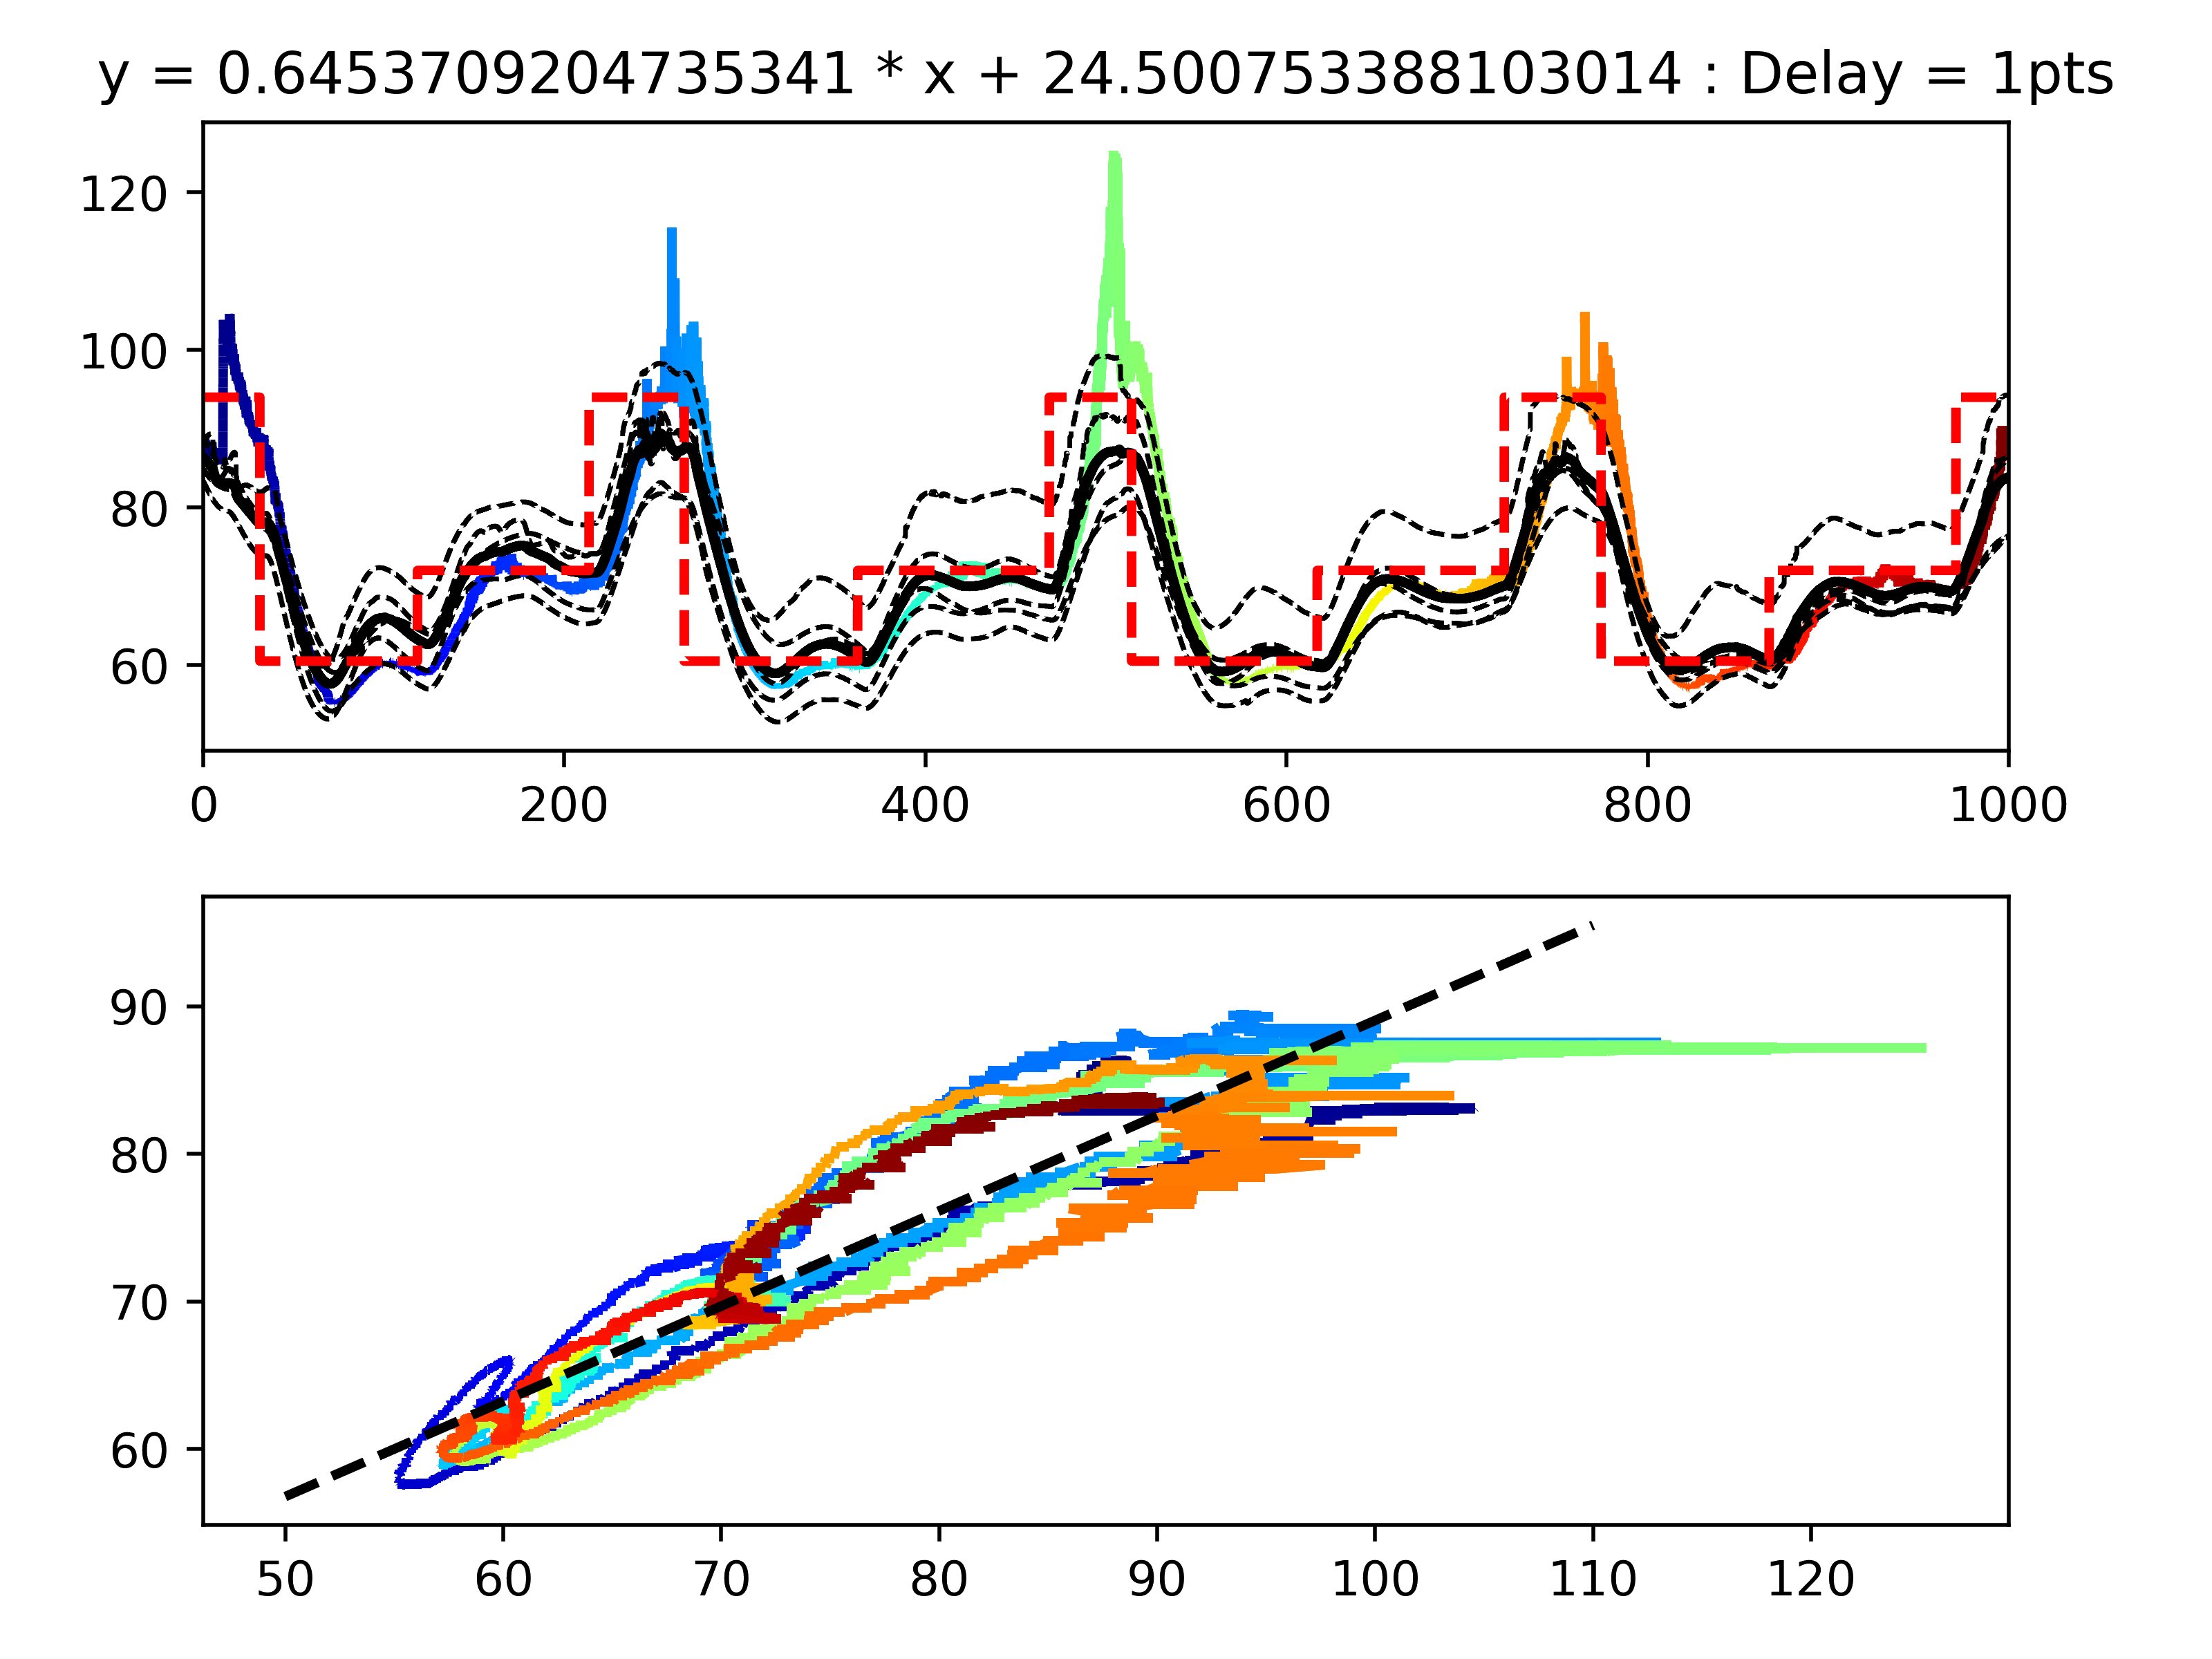
Recap Temperature Calibration
Original
After Calibration

Slide 4
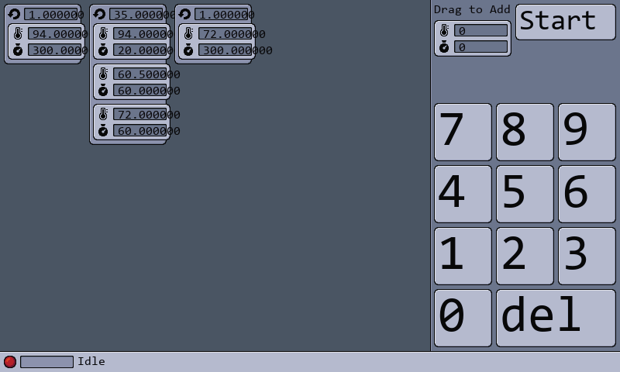
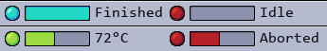
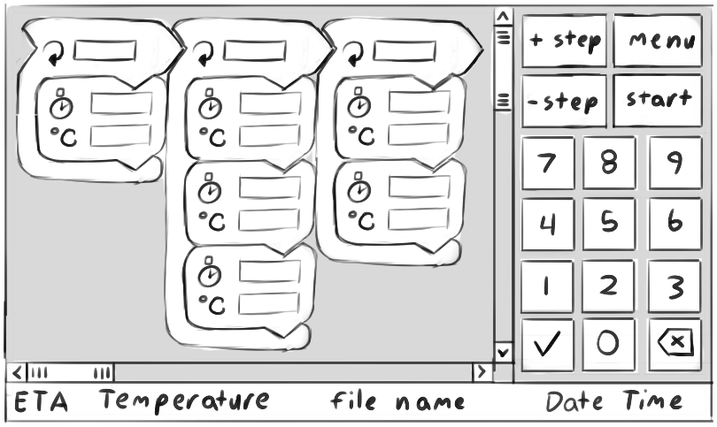
Recap FLC-PCR UI
Experiment File:
1
94 300
35
94 20
60.5 60
72 60
1
72 300

Slide 5
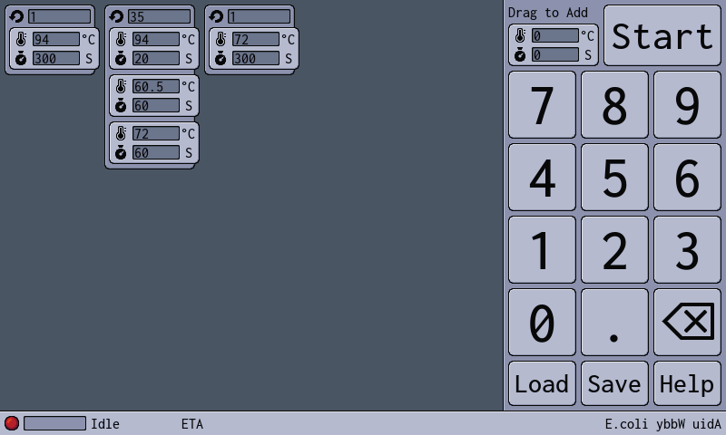
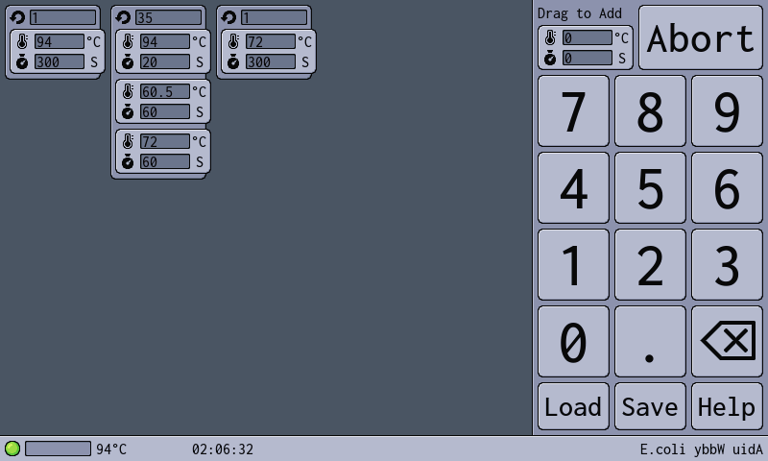
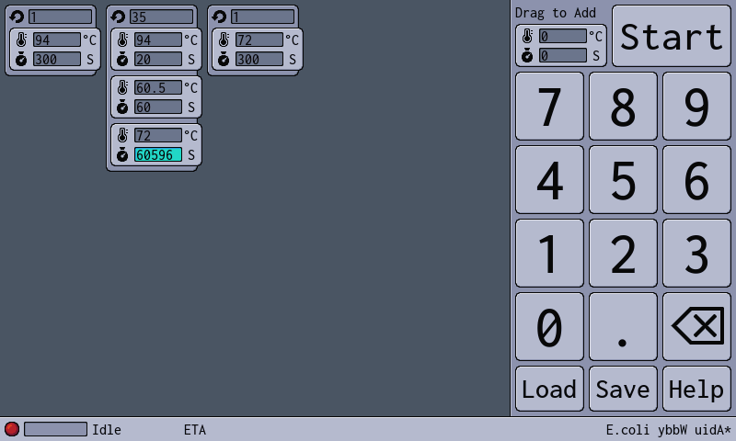
FLC-PCR UI Editor Updates
Added ETA
Added Save File display
Added Save Reminder
Fixed and Floating point support
Centered Text and fixed font size
Added Backspace Icon
Switched to the open-source font Inconsolata
Added units to cycle steps
Added load, save and help buttons
ETA
Save File with Reminder

Slide 6
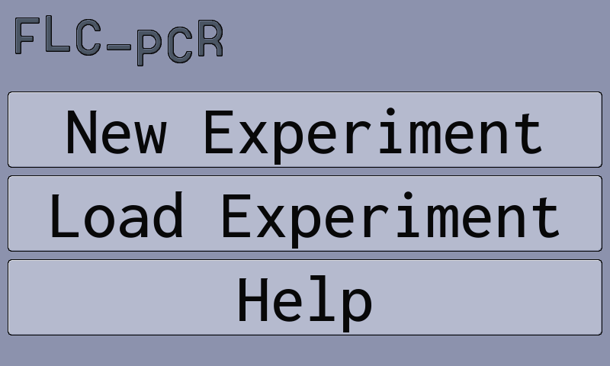
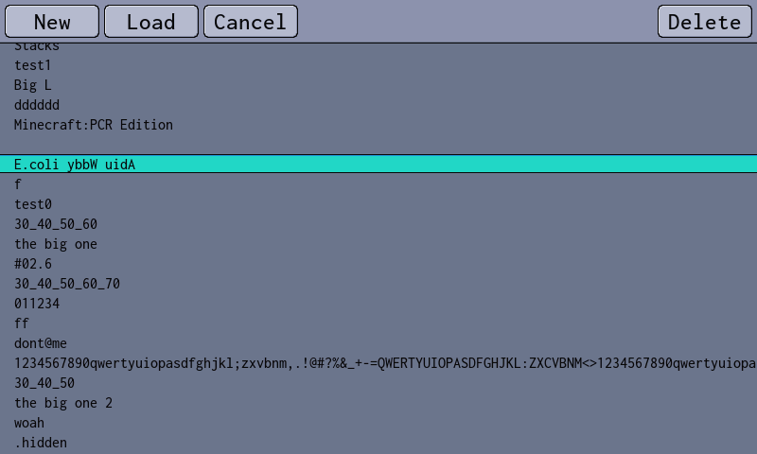
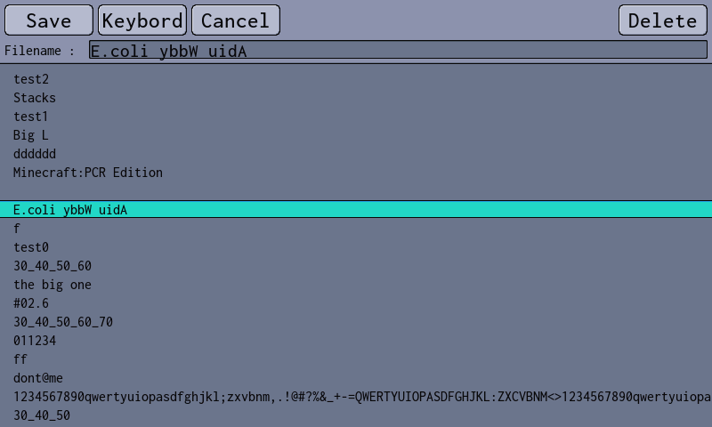
New Menus
Main Menu
Load Menu
Save Menu
Turning on Raspberry Pi boots to this menu
Animated Logo
More later…
More later…
Help menu exists but is completely empty.

Slide 7
Load Menu
Only shows files with a ‘.exp’ file extension
Has confirmation prompts for deleting files and loading while current experiment is unsaved.
Displays files in /home/pi/experiments/ and subdirectories
Fixes for problematic files such as hidden files (.hidden.exp), filenames with only whitespace ( .exp), and files with super long names still needs to be implemented.

Slide 8
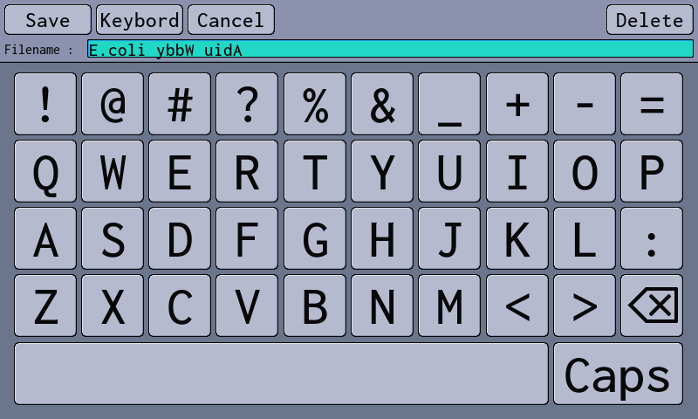
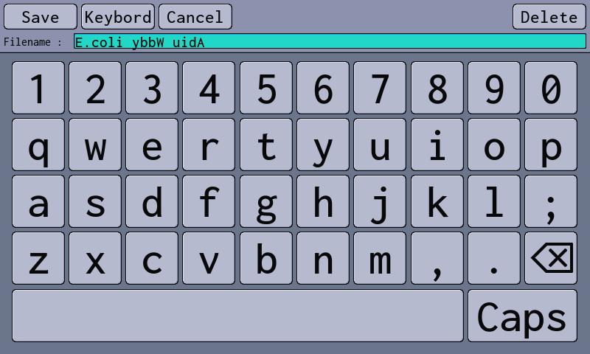
Save Menu
Same file viewer as in the load menu.
Has confirmation prompts for saving over existing files.
Tapping ‘keybord’ or on the filename text box opens and closes keybord
Again same file name problems.

Slide 9
Thank You!
Questions?

Slide 10
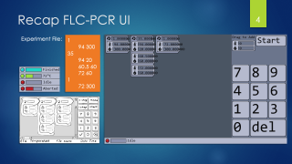
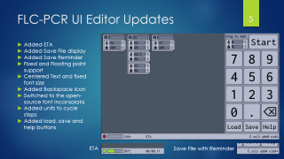
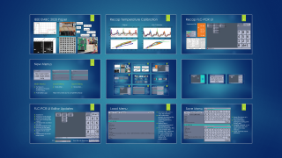
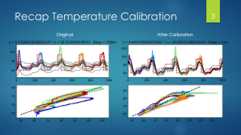
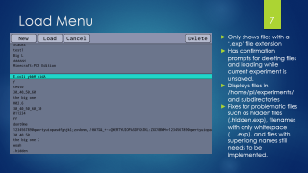
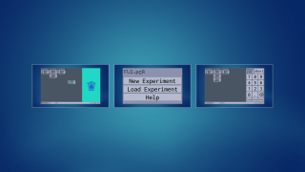
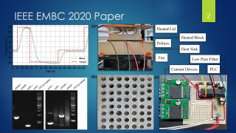
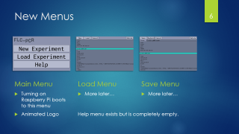
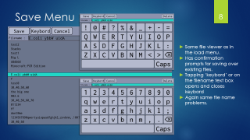
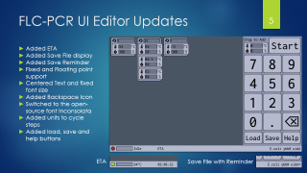



Slide 11
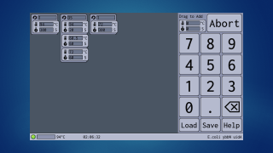
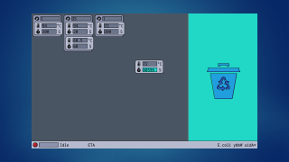
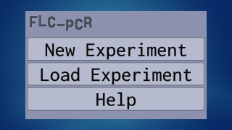

Slide 12
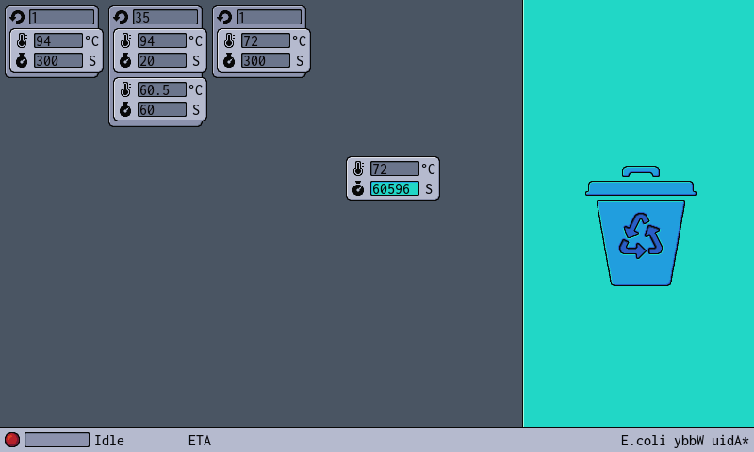

Slide 14
Notes:
Actual runtime was 2:15:44.51

